Slide 1
Talk-driven development : Teaching can be a superpower in software engineering
Vaishnavi

Slide 2
Publishing your work increases your luck

Slide 3
Publishing your work increases your luck
Luck is when something unexpected and good happens to you. Unexpected and good. Who doesn’t want to increase the odds of something unexpected and good?
How can we increase the odds of finding luck? By being a person who works in public. By doing work and being public about it, you build a reputation for yourself. You build a track record. You build a public body of work that speaks on your behalf better than any resume ever could.

Slide 4
Luck Surface Area
"The amount of serendipity that will occur in your life, your Luck Surface Area, is directly proportional to the degree to which you do something you’re passionate about combined with the total number of people to whom this is effectively communicated.“
L = D * T, where L is luck, D is doing and T is telling.
The more things you do multiplied by the more people you tell, the larger your Luck Surface Area becomes. The larger your Luck Surface Area, the more likely you are to catch luck as it flows by.
Notes:
Jason Roberts : https://twitter.com/exojason?lang=en
Coder, entrepreneur, and podcaster
@techzing
. Wrote a lot

Slide 5
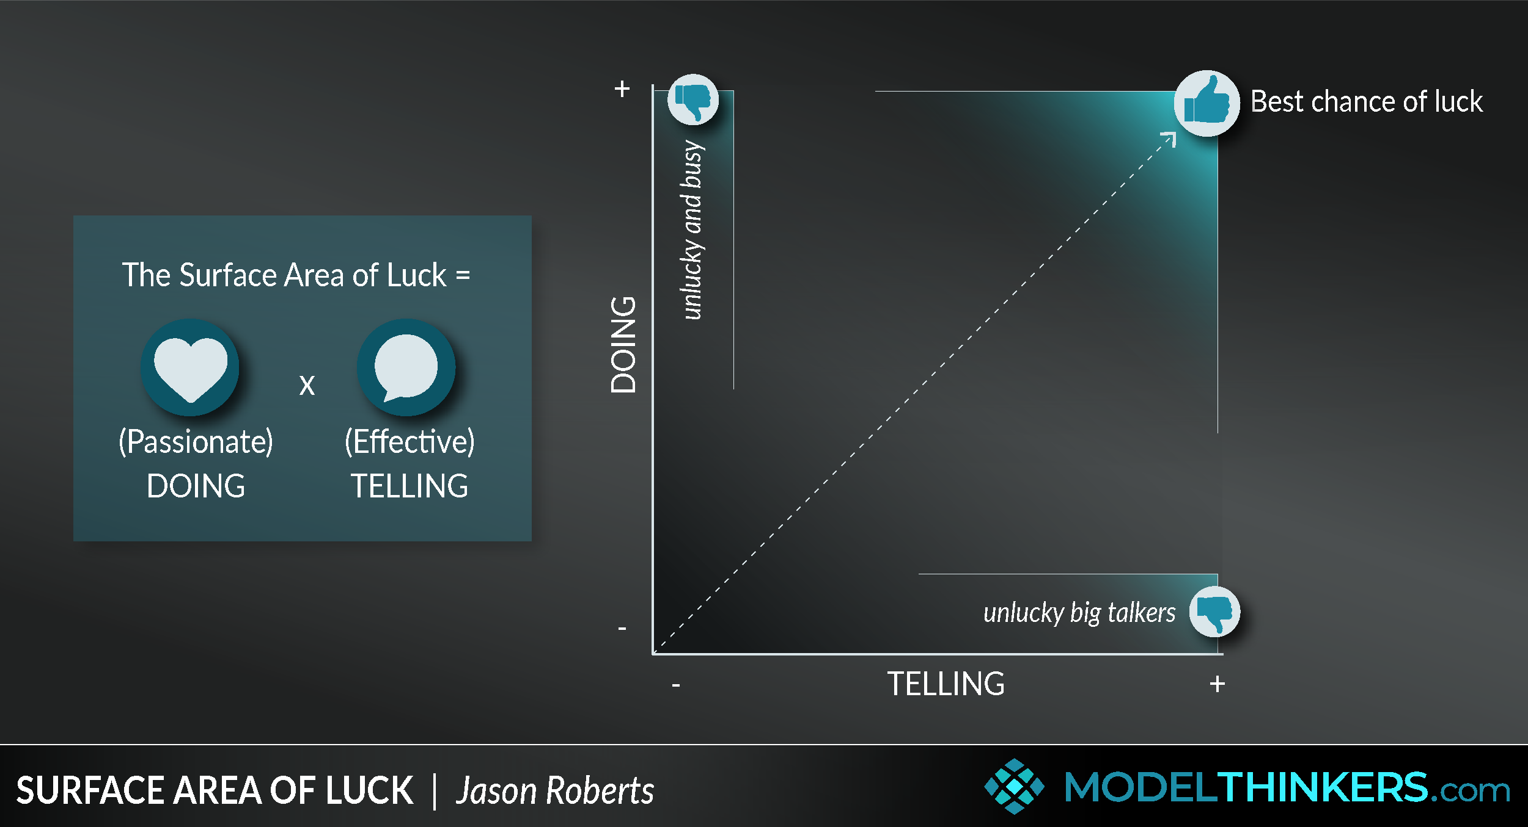

Slide 6
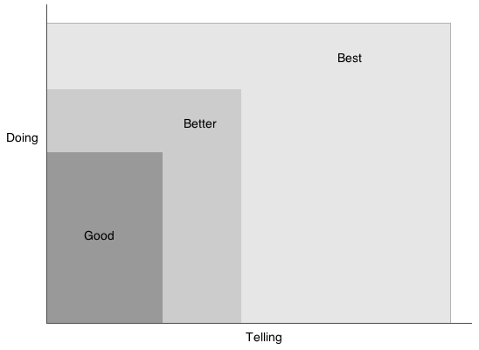

Slide 7
The law of averages refers the common belief that the relative frequency of an event should correspond to its probability. For example, if the probability of heads in a fair coin toss is 50%, then according to the law of averages, the proportion of heads in a series of tosses should be close to 50%.

Slide 8
Whatever you’re excited about, be excited about it publicly.
blogging, podcasting, commenting in online discussions, and following up with every customer and user, you increase the likelihood of having a serendipitous moment. It’s a fun concept to consider – but perhaps less of a scientific occurrence than yet another example of the Law of Averages.

Slide 9
Share Your Learnings at a Sustainable Pace
Atomic Habits by James Clear is that, over time, it’s generally more impactful to make small, consistent progress towards an identity-based goal (like being someone who runs regularly) than inconsistently focusing on one huge goal (like running a marathon).

Slide 10
The protégé effect
The protégé effect is a concept in learning that suggests we learn more effectively by teaching information to others, even if those others aren’t necessarily any less knowledgeable.
As author Robert Heinlein puts it, ‘when one teaches, two learn’.

Slide 11
process, care, and craft
Digital gardening embraces the idea that the process of documenting is more important than the final presentation.

Slide 12
References

